Slide 1
Email Writing

Slide 2

The email of the species is deadlier than the mail. Stephen Fry

Slide 3
Personal Vs Professional Emails
Personal
Informal medium
Between friends and family
Informal language (slang and emoji's)
Professional
Formal medium
Between business professionals
Peer to peer, subordinate to boss, client to business, etc.
Formal Language

Slide 4

Elements of an Email

Slide 5
Subject Line
Closing line
Signature
Salutation/Greeting
Body Paragraph/s

Slide 6
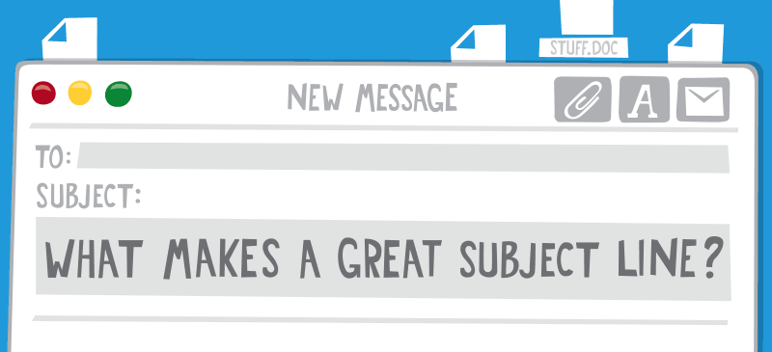
Subject line

Slide 7
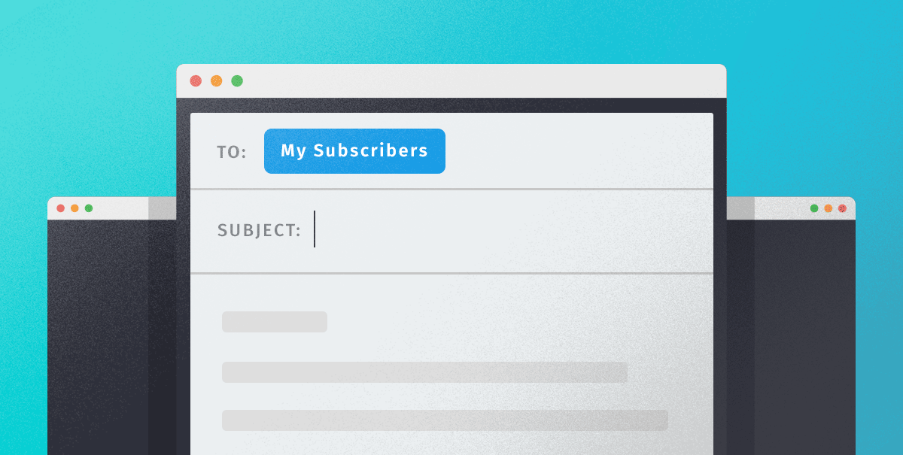
It sets the pretext of the mail

Slide 8
Your subject line should be
Precise
Concise
Relevant

Slide 9
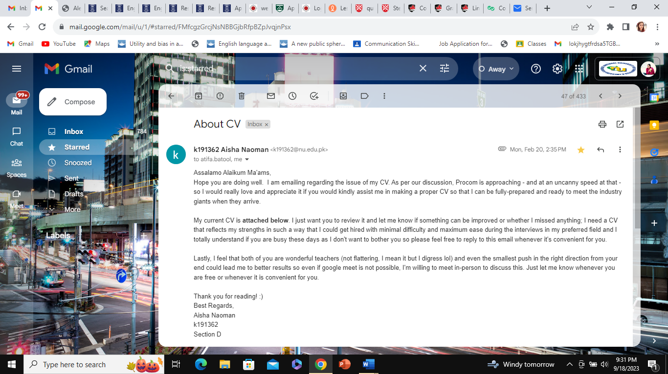
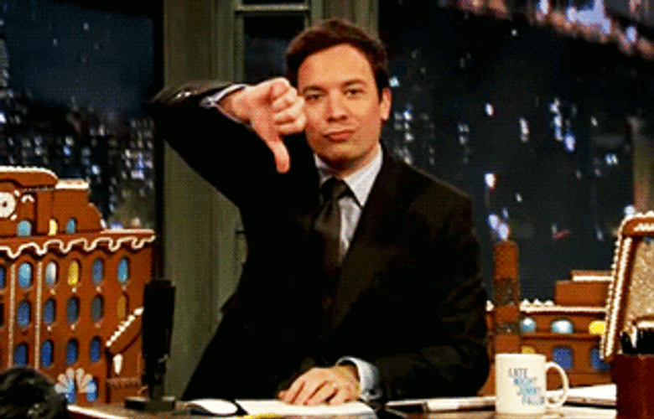
Bad Example

Slide 10
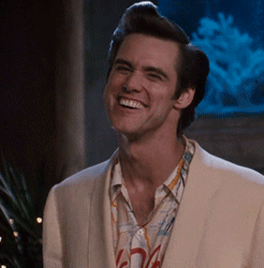
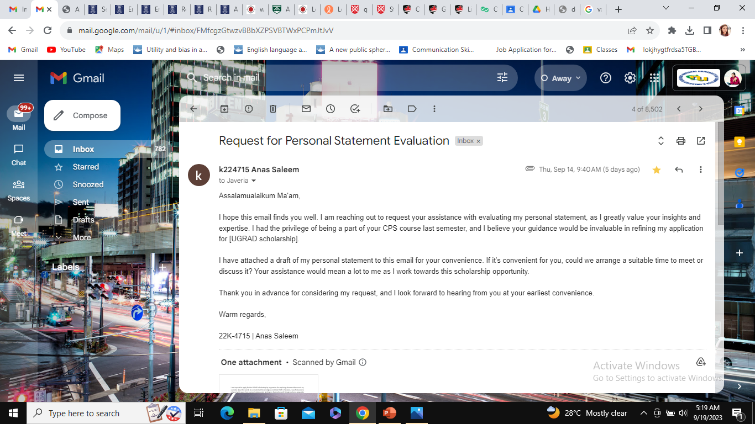
Good Example

Slide 11
More Good Examples
Examples:
“Meeting on Monday”
“Follow up re. presentation”
“Question regarding status of visa”

Slide 12
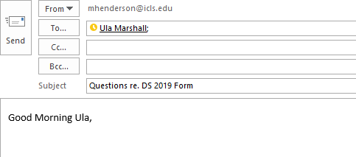
Greeting
Always start with a greeting!
Professional greeting examples:
Good Morning , Good Afternoon , Good Evening ,
Dear ,
Hello ,
Hi ,
Unprofessional greeting examples:
Hey
What’s up?

Slide 13
Greeting-In which context would you use the following titles?
Greeting + First Name
Greeting + Title + Last Name
Greeting + Department Name
Greeting + Designation Name

Slide 14

Main Paragraph/Content

Slide 15
The construction of the main content requires
Clear Organization of the ideas
Proper paragraphing, if necessary
Bullet points, if necessary
Inclusion of all the relevant details

Slide 16
You can use this format.
Purpose of the email (I am writing to inform/inquire/request, etc.)
Details of the message
Call to action
Goodwill building statements

Slide 17
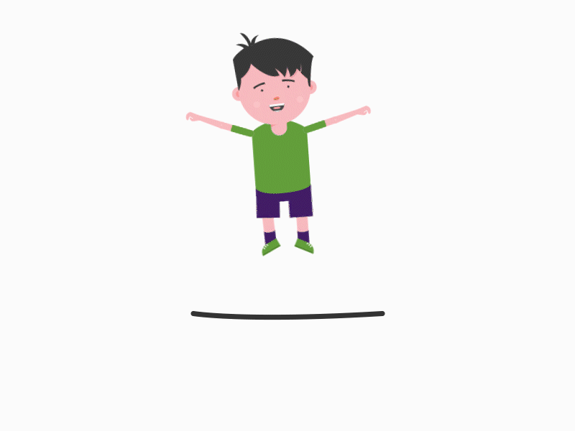
Elements of a closing line
Call to action
Polite tone
Single liner

Slide 18

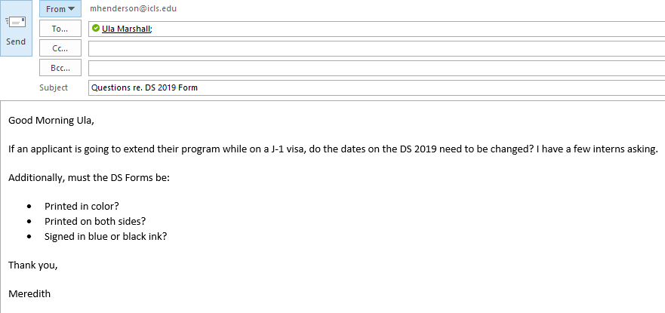
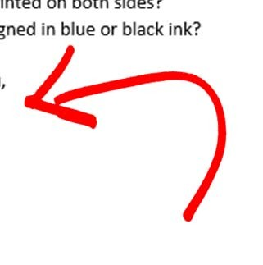
Final Compliment
Examples:
Best wishes,
Regards
Kind Regards
Sincerely,
Thank you,

Slide 19
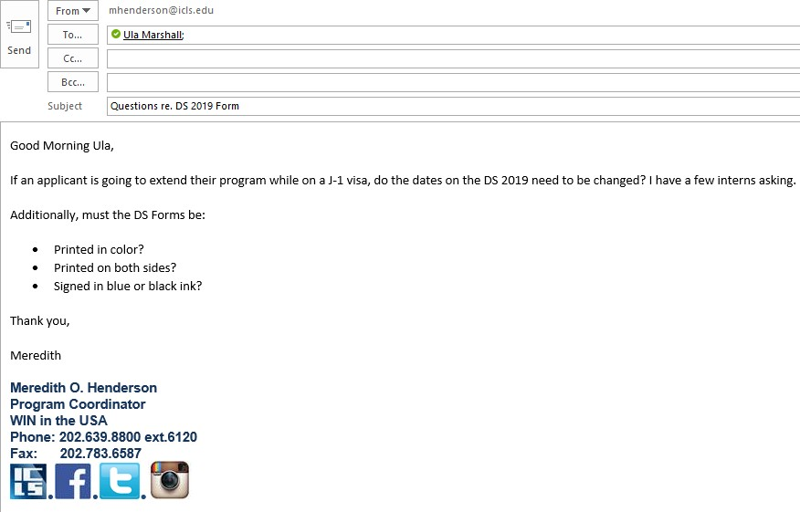
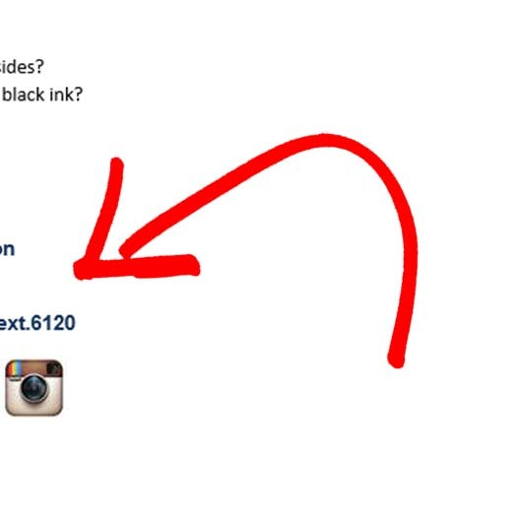
Signature

Slide 20
Designation
Your name
Contact Details
The right signature

Slide 21
Things to Avoid
Avoid using ALL CAPITAL LETTERS – it feels as if you’re shouting, and looks quite unprofessional.
Abbreviations and “text talk” are not appropriate, and should largely be avoided
ex: LOL, thx, gr8
EXCEPTIONS: ASAP, POC (point of contact), RSVP, COB (close of business)
No emoji's! The professional setting in which emoji's are appropriate does not exist.
Avoid using multiple punctuation marks:
“Can you help me?????”
“Thanks!!!!!!!!”

Slide 22
Additional Elements
Appropriate Display photo
Your complete official name
Awareness of the terms CC, BCC and Recipients
Awareness of your audience

